Slide 1
Tech Goes Home
Tools and Tips for Early Childhood Groups
Clarence Little

Slide 2
Welcome and Introductions
Name
Organization
Notes:
Welcome everyone, encourage them to make Introductions and organizations they represent.

Slide 3
Apps provided by TGH
Decide on how many TGH picked apps you will go over during a session
  Which types of apps and in what combination?
  How much time will you spend on demonstrating?
  How will you determine how much time will be parents only and parent/child time?
  How can you keep children busy with a hands-on project while you are working with the adult?
It's key for adults to feel confident with the apps so that they know best how to guide the child.​
Notes:
Encourage families to look for additional apps in the app store from developers like First 8 Studios and Duck, Duck, Moose.

Slide 4
Other apps you think are useful.
It’s also ok to introduce families to other apps that you think are helpful for the child’s development and learning.
Feel free to share your feedback with us about the provided apps, and suggestions for apps to add to the collection. You can include this feedback in your Post-Course-Survey!

Slide 5
Introduce topics that help adults support their child’s development and learning
The 3 I's Model: Introduce, Interact, Integrate
Healthy screen time use
Mixing tech with hands-on projects (for example, looking up dinosaurs and then creating a drawing or a sculpture of a dinosaur)
Other ways that they can support the child’s learning
​

Slide 6
Content for Adults
If you feel you’ve covered enough apps and parent resources, consider integrating some content solely for the adult
Do the adults in your course need support learning how to email from the iPad? Connect to family and friends with Facetime or Google Meet?
Do the adults want to learn how to search for jobs online?
Would it be helpful to show them how to order groceries or prescriptions for delivery?
Notes:
Making adults feel comfortable and enthusiastic about being learners as well.

Slide 7
Basic Insights
An extension of Boston Basics that allows parents to connect to Center for Developing Child and weekly learning tips.
Notes:
Introduce Basic Insights an extension of Boiston Basics that are a part of the many curriculum aids provided by Tech Goes Home.

Slide 8
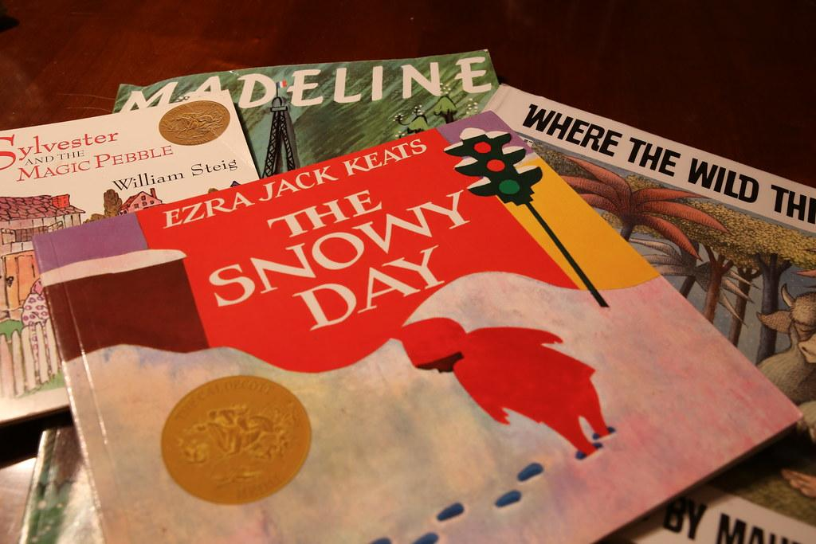

Book Report
Art Project
Notes:
Add to your curriculum differing media that can be incorporated into the TGH sessions. Send home books to read and encourage use of the local Library. Our Homework would be read the book together and both parent and child speak about what they liked and create art based on the book chosen.

Slide 9

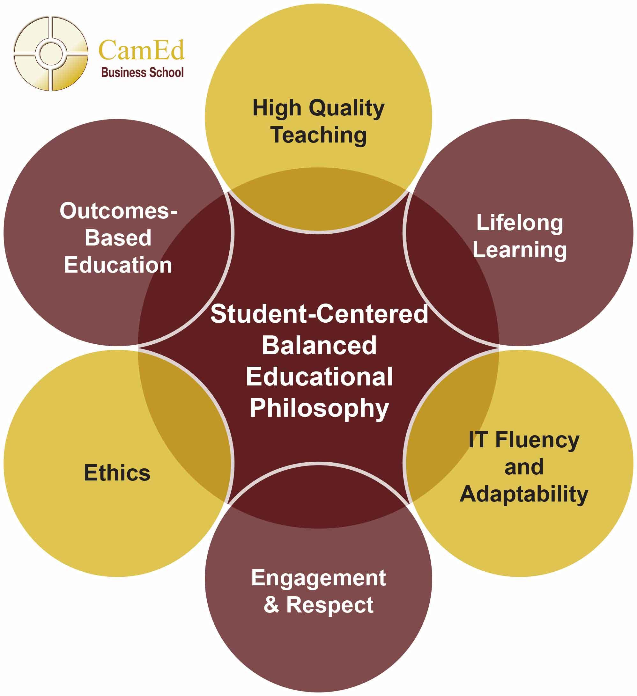

Parent Focus
Growth Within
Notes:
As we all recover from the health concerns. Be sure to emphasis self care for the whole family. Point out the apps focused on SEL. Parents say what they do for self care and happiness.

Slide 10

Ted Talks
Look for information about internet safety
Involve parents in finding out more about self care
Notes:
We use sights like Ted Talks to help parents learn more about topics of interest. As well as free online courses to help build their tech and other skills.

Slide 11
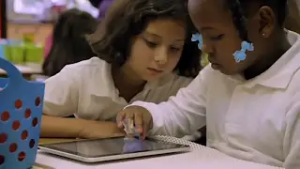
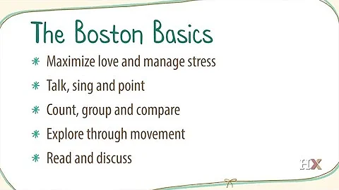
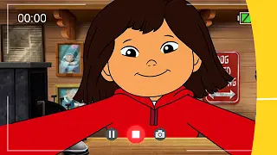
YouTube
Apple education learning with ipad us
Molly of Denali Behind the scenes with Creators
Notes:
We use Youtube for video content as well as a strong emphasis on PBS Kids. We also show the varied and lifelong uses this device can support for learning.

Slide 12
Virtual Tour
One of our interactive weekend assignments is a virtual tour of a museum.
Notes:
One of our family outings is a virtual tour of any Museum. Have the child create an art project based on the experience. For example one child liked the pyramids. The Father and Son built one with blocks.

Slide 13
Curriculum Example
Group meets Tuesday and Thursday for 1 hour each session
Day 1: Introduction and overview Day 7: Review of PBS Kids Art and Report
Day 2: Internet safety and IPad info Day 8: Library Books day
Day 3: Google and App review Day 9: Book reports and family art
Day 4: Boston Basics and Self Care Day 10: Virtual Museum Tour Kids Choice
Day 5: Apps to focus on Day 11: Art and Report
Day 6: PBS Kids day Day 12: STEAM
Notes:
Here is an example of our curriculum. It can change for different groups and there are always 3 Free Choice days for families and children to decide what they want to focus on.

Slide 14
Websites
Resources for Parents
https://www.wgbh.org/distance-learning-center/family-activities
https://thebasics.org/basics-insights/
https://Colorincolorado.org
https://resourcesforearlylearning.org
https://developingchild.harvard.edu
Notes:
List of websites for further information.

